Slide 1
OSL640: Introduction to open source systems Week1: lesson 1 Course Introduction / Unix and Linux Background ACCESSING YOUR Linux Matrix server account
Photos and icons used in this slide show are licensed under CC BY-SA

Slide 2
Lesson 1 topics
Why I am Taking This Course? (Course Introduction)
Instructor Information / Purpose of Course
Foundations For Future Courses
Course Resources / Course Outline / Course Policies
Background and Features of UNIX and LINUX OS
Purpose of an OS / History of Unix & Linux OS
Features of Unix / Linux OS
Matrix Linux Server
Purpose / Layout
How to Access your Matrix Linux Account:
From Seneca Lab Workstation
From Laptop or Home Computer (Windows, Mac OSX, Linux)
How to Logout of your Matrix Linux Account

Slide 3
Course Introduction
Why am I Taking This Course?
Unix and Linux are commonly used operating systems in the IT industry. You are required to learn important technical skills in order to be successful in future courses and your career.
In this course, you will learn core utilities to work productively in a Unix / Linux operating system environment including the following topics:
Issuing Linux commands and utilities
Manipulating data stored in regular text files
Managing files and directories (including access & permissions)
Writing basic shell scripts
Configuring login accounts

Slide 4
Course Introduction
Foundation for Future Courses
The following table shows the various courses that require Linux skills for the Business Information Technology program.
Business Information Technology
OSL740 (Administration of Open Source Systems) OSL840 (Advanced Administration of Open Source Systems) ADM950 (Enterprise Project) SEC935 (Security Operations and Administration) SOA915 (Service Oriented Architecture)

Slide 5
Course Introduction
Course Resources
Resources | Purpose
OSL640 WIKI: https://wiki.cdot.senecacollege.ca/wiki/OSL640 | Course Outline / Course Policies Weekly Schedule (notes, tutorials, practice questions) Tutorial Instructions
Learning Content Management System (Blackboard) https://my.senecacollege.ca/ | Course Marks (located in My Grades) Link to the OSL640 WIKI Online Quizzes / Online Tests
The Linux Documentation Project http://en.tldp.org/ | Vast online Linux Documentation HOWTOs, Guides, FAQs

Slide 6
Course Introduction
Faculty Information
Please note and record the following information in class:
Instructor’s Full Name
Instructor’s Office Location
How to Contact OSL640 Instructor:
E-mail Address
Web Presence

Slide 7
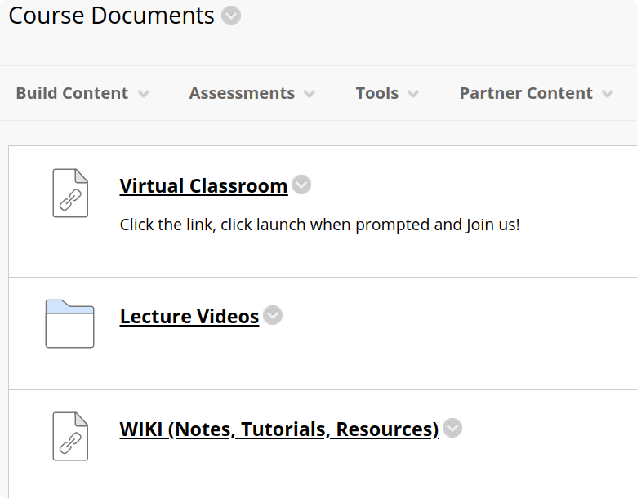
Course Introduction
Blackboard: Course Documents (Jason Carman’s OSL640 Sections)
In the Course Documents section of your Blackboard OSL640 course, there are several resources which include:
Virtual Classroom will take you into our synchronous (meaning we are all online together) Lab sessions.
Lecture Videos contains the lecture recordings. All except the first week will be delivered asynchronously (meaning you will watch a pre-recorded video before your Lab session).
A Link to the OSL640 WIKI that contains weekly lesson slides and tutorials.
Quizzes & Tests can be found under Course Documents (in the main navigation).

Slide 8
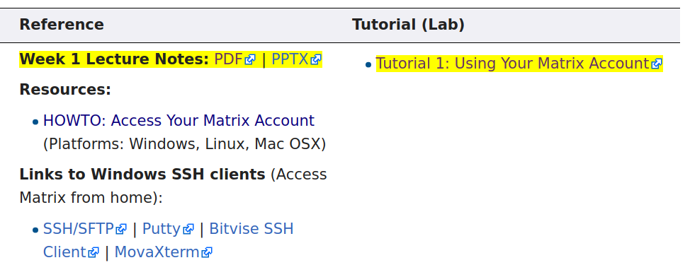
Course Introduction
OSL6401 WIKI
Main WIKI Page (Quick Links)
The Quick Links section on the top-right corner provide links to the weekly schedule, course outline and course policies
Weekly Schedule Page
The weekly Schedule provides lecture notes (under Reference section in both PDF and PowerPoint format). The Tutorials section contains a weekly hands-on tutorial that provide the student guided practice to become familiar with working in the Linux environment. These make up 30% of your final grade.
NOTE: The areas highlighted in YELLOW are important (either lecture content or tutorial) for each week.

Slide 9
Course Introduction
Course Outline
Link: https://ict.senecacollege.ca/course/osl640/
Topics
Course Description
Modes of Instruction
Evaluation / Promotion Policy
Learning Outcomes / Topic Outline

Slide 10
Course Introduction
Course Policies
Link: https://wiki.cdot.senecacollege.ca/wiki/Course_Policies_for_OSL640
Topics
Tutorials
Quizzes, Test, and Project
Cheating & Plagiarism
What constitutes cheating?
General Information

Slide 11
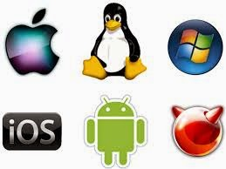
UNIX and LINUX Background and features
Purpose of an Operating System
An operating system basically performs 2 major tasks:
Manages Resources to provide a platform for application to run
Interface to allow the OS to communicate with the end-user (Humans)
Over time, operating systems used a command line interface, then evolved into a menu-driven interface, then finally a graphical user interface (GUI).
Depending on the OS installation setup, modern operating systems can provide ALL of the above-named types of interfaces to help accommodate all users’ preferences.

Slide 12
UNIX and LINUX Background and features
History of Unix
Although Unix was not the first operating system, it made a huge impact in the 70’s and is still a popular OS today.
Interesting Facts:
The UNIX OS was developed in the early 70’s by Ken Thompson as a platform to play a crude network strategy-based game called “space travel”.
UNIX was developed at AT&T Bell labs, but it took the company a few years to realize that this OS would be popular and marketed proprietary version that became Unix System V (release 4).
While Ken Thompson took a break from work and taught at University of Berkley California, he provided students source code to OS and Shell (interface) which branched into a free version of the OS that became BSD (Berkeley Software Distribution) Unix.

Slide 13
UNIX and LINUX Background and features
History of Unix / Continued…
Unix was developed to incorporate the following features:
Allows for multiple users – this is performed by assigning each user a “small slice of time” to give illusion that computer is paying total attention to that user.
Allows for multi-tasking – allows for more than one task to be executed at the same time (e.g. via a “time-slice”).
Supports multi-processing (allows tasks to be performed on multiple processors).
Simplifies sharing of data and programs among users.
Unix also evolved at the time that ARPANET (an ancestor to the Internet) was evolving which made it easier to setup computer networks and use networking and eventually Internet related utilities.

Slide 14
UNIX and LINUX Background and features
History of Unix / Continued…
Unix was re-written using the C programming language to make the OS more portable to install and operated on other types of computers.
Hardware manufacturers modified UNIX to run on their systems and added enhancements.
Versions of Unix (both propriety and free) became standardized to be accepted and used by industry and government organizations (e.g. POSIX standard).

Slide 15
UNIX and LINUX Background and features
History of GNU / Linux
Richard Stallman published the GNU Manifesto in 1984, which described the need for Free Software ("Free in the sense of free speech, not free beer"). The resulting GNU project developed free, open-source replacements for most of the Unix programs, but not for the Unix kernel (the core program that interacted with and controlled the hardware).
These programs were released under the GNU General Public License (GPL), which permits anyone to copy, use, and modify the software, as long as these rights are preserved for anyone receiving a subsequent copy of the software.
Under the GNU project, there were many free utilities that were available for a Unix-Like OS, but the Unix-like OS for PCs that Richard was developing was not stable and another Unix-like OS for the PCs became available called Linux.

Slide 16
UNIX and LINUX Background and features
History of GNU / Linux (Continued…)
In 1991, Linus Torvalds, a Finnish computer programming student, released the Linux kernel, eventually placing it under the GPL.
The Linux kernel, GNU software, and some other components were combined into a powerful, Unix-like operating system.
This OS can’t technically be called Unix, because it has never been certified to be Unix, but virtually everyone in the industry regards it as such.
The combined GNU and Linux system is called “GNU/Linux” by some but just “Linux” by others (much to the dismay of Richard Stallman) who feels that the simple name Linux downplays the tremendous contribution made by the GNU Project.

Slide 17
UNIX and LINUX Background and features
Linux Distributions
Today there are many different distributions (or versions) of Linux. Some of them have specialized uses while others are more of a general-purpose Operating System. Linux can be found all around us – powering websites we access, the cloud and even the mobile devices we use. Android Smart Phones and Tablets are powered by the Android Operating System, which is based on a modified version of the Linux kernel.
All of these different Linux distributions can be traced to a few base parent distributions or families (depicted on the next slide). These are:
Ubuntu / Debian
Arch
Red Hat / Fedora / Mandriva
Slackware
Gentoo
Additionally, there are several Linux distributions that exist independently of these families

Slide 18
Periodic table of linux distributions (distros)

Slide 19
Matrix Linux Server
While attending Seneca College, you will be using many different computer systems to perform various operations. Below is a listing of a few of these servers:
Students will mainly use a web-browser to interact with those listed servers.
An exception is the Matrix server which requires that students run an application to connect to their server account to practice Linux commands, perform and submit their tutorials.
my.senecacollege.ca | Learning Content Management System (Student Grades / Notes / Online Quizzes)
ict.senecacollege.ca | Main ICT Webserver
wiki.cdot.senecacollege.ca | Course WIKIs for Seneca College Students
matrix.senecacollege.ca | Linux Account for Student Practice and Assignment submission

Slide 20
Matrix Linux Server
The Matrix server consists of several Virtual Computers connected to form a cluster. A cluster is a cost effective alternative to buying larger servers.
All registered students in this course have access to an account on the Matrix server. You will be using this account for the following reasons:
Issuing Linux commands
Practicing Linux commands at the Linux shell to be more productive
Performing Linux Online Tutorials (12)
Practice Issuing Linux Command Review Questions

Slide 21
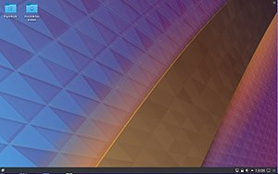
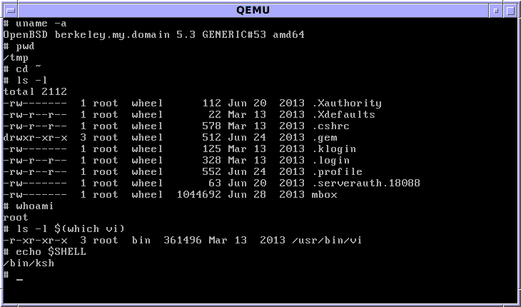
Matrix Linux Server
Communicating with Matrix Server In UNIX / LINUX, a shell refers to an interface that allows a user to communicate with the OS.
UNIX / LINUX has the ability to install a GUI (Graphical User Interface) that allows the user to launch applications via icons, graphically manage files, etc.
On the other hand, due to bandwidth issues and the large number of Seneca students that remotely connect to the Matrix server, it is NOT feasible to connect via a GUI.
Therefore, it is only possible to interface with your Matrix account via a CLI (Command Line Interface), where students issue Linux commands to launch applications, manage files, etc..

Slide 22
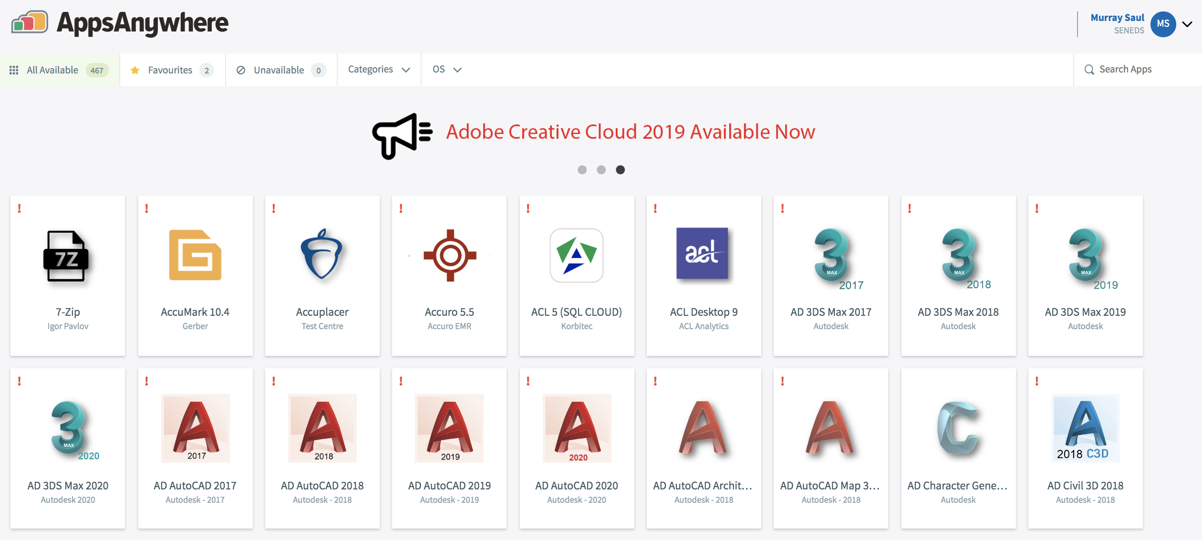
Matrix Linux Server
Accessing Matrix from Within College:
You can access your Matrix Linux account from a workstation located in any Seneca lab, or from your own computer (e.g. laptop or home computer).
Accessing Matrix from Lab Workstation:
MyApps is an application streaming service that lets you run software on any Seneca Workstation on demand. Any software application on the MyApps menu can be used on computers in classrooms, labs, and the Computing Commons.
Reference: https://inside.senecacollege.ca/its/software/myapps/

Slide 23
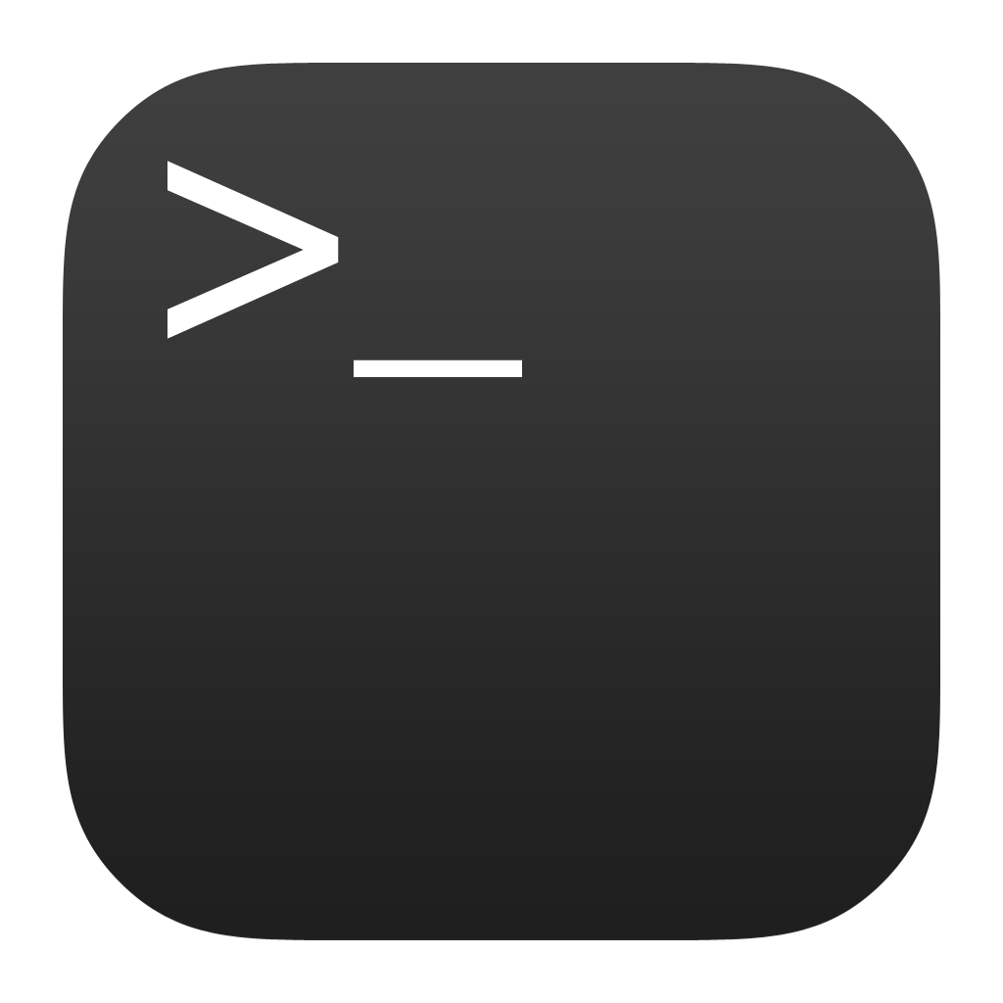
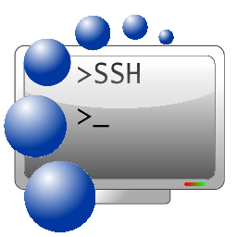
Matrix Linux Server
Accessing Matrix from Remote Computer:
Due to the COVID19 Pandemic, ICT students are required to learn remotely (i.e. not at Seneca College).
You can also do this by command-line (eg. ssh command) or by running a graphical SSH application (eg. SSH Secure Shell Client).

Slide 24
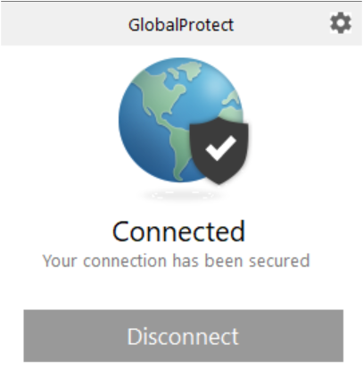
Matrix Linux Server
Connecting to the Seneca GlobalProtect Student VPN All Seneca College students are required to FIRST connect to the Seneca GlobalProtect Student VPN in order to be able to connect to their Matrix Linux account. Seneca College are "rolling-out" additional measures to improve network security. One of these measures are to implement multi-factored authentication.
Multi-factor authentication is an electronic authentication method in which a computer user is granted access to a website or application only after successfully presenting two or more pieces of evidence (or factors) to an authentication mechanism: knowledge (something the user and only the user knows). Reference: https://en.wikipedia.org/wiki/Multi-factor_authentication NOTE: If you haven't done this yet, please perform the steps provided in the following link: https://employees.senecacollege.ca/spaces/77/it-services/wiki/view/3716/vpn

Slide 25
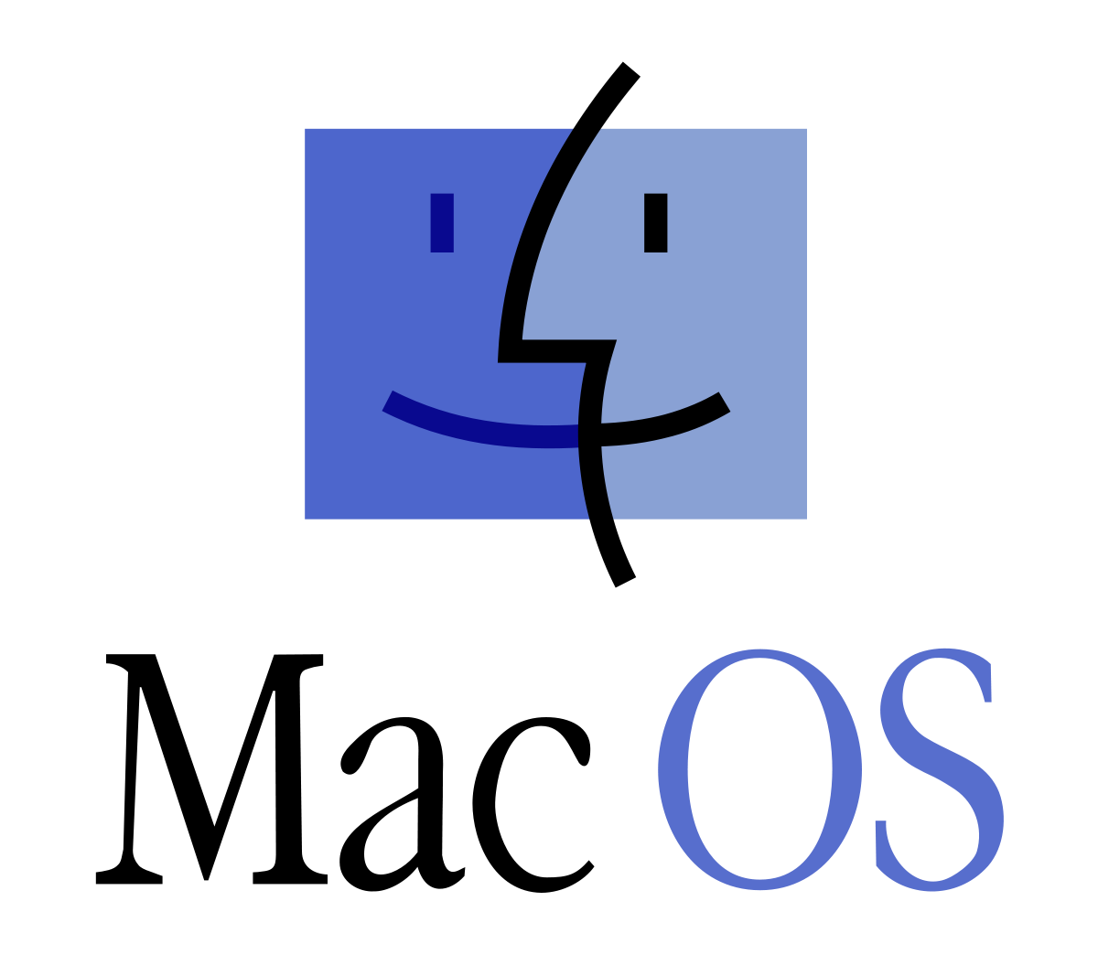
Matrix Linux Server
Accessing Matrix Using New Windows 10, Mac OSX or Linux Computer:
SSH from Windows 10 OS (Newer Version)
From the start menu, type cmd and click on cmd icon to launch.
In the command line, enter the following command: ssh senecausername@matrix.senecacollege.ca
Enter your password when prompted., answer yes to any questions it may ask you.
SSH from macOS
Click Launchpad icon and type terminal and press ENTER
On the command line, type: ssh senecacusername@matrix.senecacollege.ca
Enter your password when prompted. Answer yes to any questions it may ask you.
SSH from Linux
From the main menu, choose Applications > System Tools > Terminal
On the command line, type: ssh senecac username@matrix.senecacollege.ca
Enter your password when prompted. Answer yes to any questions it may ask you.

Slide 26
Matrix Linux Server
Accessing Your Matrix Account:
You will need to provide the domain (host) name of the Matrix server, your username and password to access the Matrix server.
Your Matrix username and password is identical to your myseneca username and password.
NOTE: You can use the hostname matrix since you are located inside Seneca's network. If you were located outside Seneca's network, then you would need to enter the full domain name: matrix.senecacollege.ca

Slide 27
Matrix Linux Server
Instructor Demonstration:
Your instructor will demonstrate how to connect to the Matrix server by issuing a command.

Slide 28
Matrix Linux Server
Alternative Method: Accessing Matrix Using SSH Application (MS Windows)
You can also install and run a free graphical SSH application in order to connect to your Matrix account. You may find it useful when running a graphical SSH application to copy and paste text.
Click the following link to download and install application on your Windows computer: http://www.sfsu.edu/ftp/win/ssh/SSHSecureShellClient-3.2.9.exe
After the application has been installed, it should appear as an application icon on your desktop. Double click the SSH Secure Shell Client application icon.
The main SSH Client window will appear. Click on the Quick Connect button.

Slide 29
Matrix Linux Server
Instructor Demonstration:
Your instructor will demonstrate how to connect to the Matrix server by and installing and running an SSH application.

Slide 30
Matrix Linux Server
Accessing Your Matrix Account:
When connecting securely for the first time, a dialog box will appear to share a "public key" with your Matrix account in order to make your interaction between your workstation and the remote Linux server secure within the network (i.e. encrypted to prevent unauthorized access by other users).
Matrix has only a Command Line Interface (CLI)
The Matrix server has been configured to allow users to only interact with the Linux OS by issuing commands. There are various reasons for this, but the main 2 reasons are to force students to learn how to issue Linux commands as well as learning to combine Linux commands in a file called a shell script to automate common tasks.
Later in the course, your instructor may demonstrate other ways of accessing graphical versions of Linux, and how to launch a shell terminal.

Slide 31
Matrix Linux Server
Logging Out of Your Matrix Linux Account:
When you want to log-out of your Matrix server account, you can enter the commands exit, logout, or press the shortcut key: <ctrl><d>
NOTE: You should exit by issuing a command or shortcut key as opposed to closing the SSH application window.

Slide 32
Hands-on Time / HOMEWORK
Get Acquainted with the OSL640 WIKI, notes, tutorials and resources.
Perform the following investigations in Tutorial 1: INVESTIGATION 1: USING YOUR MATRIX LINUX ACCOUNT

Slide 33
OSL640: Introduction to open source systems Week1: lesson 2 issuing Linux commands / Linux command help command line editing ONLINE tutorials / Student Learning groups performing online ASSIGNMENTS
Photos and icons used in this slide show are licensed under CC BY-SA

Slide 34
Lesson 2 topics
Using Your Matrix Account
Issuing Linux Commands / Arguments / Options
Command Help / Command Line Editing
General Linux Commands
Getting Practice Issuing Linux Commands
Tutorials with Linux Practice Questions
Student Learning Groups
Performing Online Assignments
Homework
Perform Tutorial 1 – Investigation #2

Slide 35
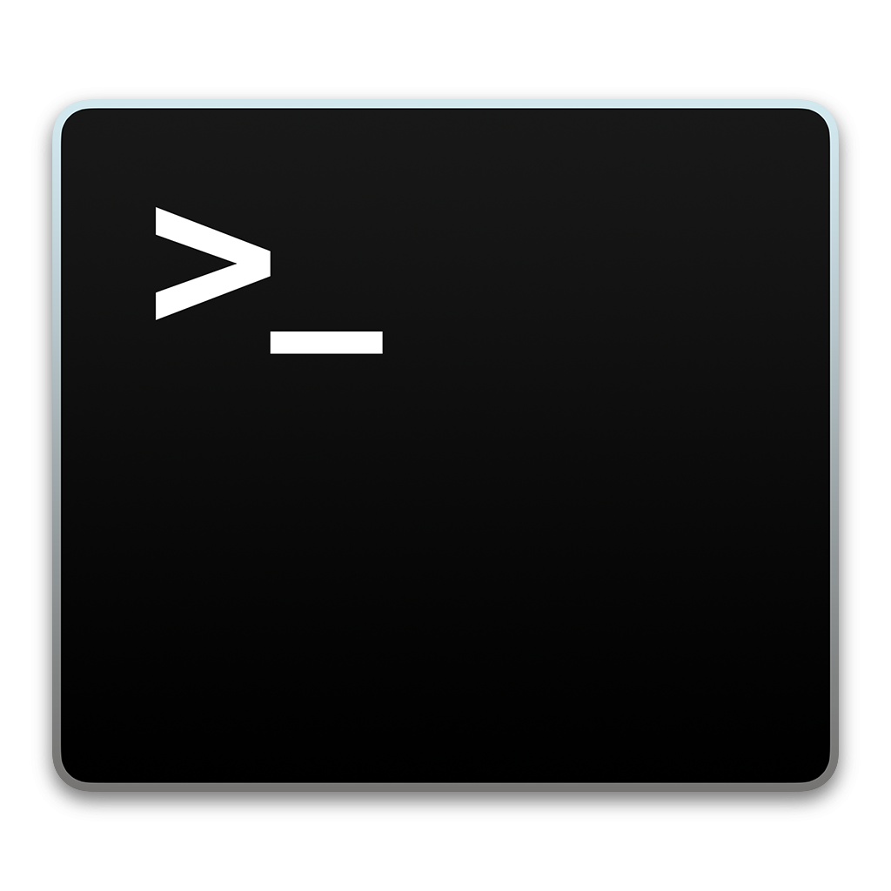
Using your matrix account
Linux Command Structure
command argument1 argument2 ...
Some Linux commands can be issued by entering the Linux command line without arguments (e.g. pwd, date, ls, cal), but some Linux commands can be issued with arguments (e.g. cal 2002, cd /bin, ls -la ).
An argument can be a file pathname, text, or an option.
Examples:
The ls command displays a listing of just filenames in the current directory
The ls /bin command displays a listing of filenames in the /bin directory (as opposed to your current directory)
The ls -l command displays a detailed listing of filenames in the current directory
The ls -l /bin command displays a detailed listing of files in the /bin directory

Slide 36
Using your matrix account
Getting Help with Linux Commands
With the Linux OS containing over 2500 commands and utilities, it is good for a Linux user or Linux System Administrator (i.e. sysadmin) to learn about how to use commands “on-the-fly”.
The man command can provide information on how to use a command (i.e. usage, arguments, options, examples). The commands are classified into sections or “volumes”. Example: man ls
If you do not know the name of a Linux command, the man utility can be used with the -k option to help list Linux commands that match a text pattern that is contained within the help screen for a Linux command. Example: man –k copy

Slide 37
Using your matrix account
Getting Help with Linux Commands / Continued…
You can use the following short-cut keys within the man command to help navigate throughout this utility to get help with the specific command (refer to table below):
Keyboard Shortcut | Purpose
ENTER | Move down one line
SPACEBAR | Move one screen down
<ctrl><b> | Move one screen up
/pattern | Search for Pattern
q | quit man utility

Slide 38
Managing Directories
Instructor Demonstration
Your instructor will demonstrate how to use the man pages command.

Slide 39
Using your matrix account
General Linux Commands
Your instructor will demonstrate several basic Linux commands to get practice how to issue Linux commands and using arguments and options.
Shortcut Key(s) | Arguments / Options | Purpose
pwd |  | Display Current Working Directory
cd | dir-pathname | Change Directory
ls | -l, -a, -R, -d, dir-pathname | List Files of Directory
cal | month, year | Display calendar
date |  | Display date and time
who |  | List users logged into server
whoami |  | Display username of user logged in
clear |  | Clear Screen
passwd | username | Change user’s password

Slide 40
Using your matrix account
Command Line Editing
Learning shortcut keys in any OS terminal will allow you to be more productive as a sysadmin. We will only focus on a few command line editing keyboard shortcut keys.
Shortcut Key(s) | Purpose
<ctrl><l> | Clear Screen
<ctrl><u> | Clear Command Line
<Up Arrow> , <Down Arrow> | Scroll Up / Down Command History
<backspace> , <ctrl><backspace> , <ctrl><h> | Delete character before the cursor
<ctrl><w> | Delete word before the cursor
<ctrl><a> | Move cursor to beginning of command line
<ctrl><e> | Move cursor to end of command line
<alt>f/<alt>b (Mac: OPTION+Right/Left-Arrow) | Move Forward/Backward one word
NOTE: If you are using a Graphical SSH application, you would need to configure the application (META settings) to NOT bring up menus by mistake when you issue some of these shortcuts.

Slide 41
Managing Directories
Instructor Demonstration
Your instructor will demonstrate how to issue general Linux commands and perform command line editing.

Slide 42
Getting practice issuing linux commands
Tutorials / Linux Practice Questions There are tutorials that are available for students to get “hands-on” practice issuing Linux commands. These tutorials contribute to 30% of your final grade if completed by the due date.
It is highly recommended that you perform them and answer the Linux Practice Questions at the end of the tutorials. Weekly tutorials are highlighted in yellow (like weekly slides).
The best way to pass this course is to complete the tutorials and submit them on time. All of the assessments will derive from the tutorials and lecture content.

Slide 43
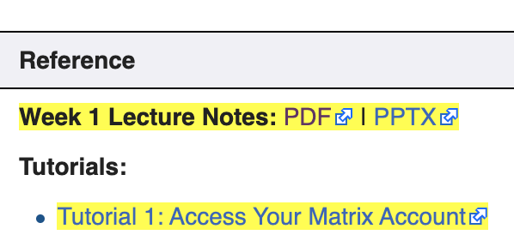
HOW TO BECOME SUCESSFUL in this course
Performing Tutorials
At the end of each lesson, you will be directed to perform section(s) of the weekly tutorial (link contained in the OSL640 WIKI’s Weekly Schedule).
The tutorials are designed to provide you guided hands-on practice with Linux commands and operations that will help you get practice prior to performing your assignments. Depending on your instructor, these tutorial may be worth marks (and assigned a due date). Linux Practice Questions are located at the bottom of each tutorial.
Students that take the time to perform this tutorials tend to complete the online assignments faster and perform better on quizzes and tests!

Slide 44
HOW TO BECOME SUCESSFUL in this course
Project
You are required to complete a final project (in place of a final exam) in the second half of this course. This project is based heavily on Tutorial 7 and will include both a:
Presentation (including live demonstration)
Documentation Report
This can be completed individually or optionally in groups of two.

Slide 45
Getting practice issuing linux commands
Need Additional Help? Try the Learning Centre: https://www.senecacollege.ca/ce/info/services/learning-centre.html
ONE-ON-ONE TUTORING Appointments focused on your individual needs that explain course concepts.
ENGLISH LANGUAGE SUPPORT Offered through individual appointments or group learning sessions to focus on grammar, academic writing, conversation, and pronunciation.
STUDY SKILLS Learn time management, exam preparation, critical thinking, note-taking, and reading.

Slide 46
Hands-on Time / HOMEWORK
Get Acquainted with the OSL640 WIKI, notes, tutorials and resources.
Perform the following investigations in Tutorial 1: INVESTIGATION 2: USING THE LINUX SHELL / ONLINE ASSIGNMENTS LINUX PRACTICE QUESTIONS 1 – 9 (will be taken up at beginning of next class)

