Slide 1
OSL640: INTRODUCTION TO OPEN SOURCE SYSTEMS
Week 6: transferring files between computers
ISSUING REMOTE COMPUTER COMMANDS ON LOCAL COMPUTERS
Photos and icons used in this slide show are licensed under CC BY-SA

Slide 2
Lesson 1 topics
Transferring Files Between Computers:
SSH Suite of Utilities:
  Purpose / Using the scp utility / Using the sftp utility
  Issuing commands on remote computers from local computers (ssh [Linux Command(s)])
  Demonstration
Mail Utility:
  Purpose / Using the mail utility
  Sending Messages / File Attachments
  Demonstration
Perform Week 6 Tutorial
  Investigations 1, 2 & 3
  Review Questions (Questions 1 – 12)

Slide 3

Transferring files between unix / Linux servers
It is important to learn how to transfer files from your Matrix account to other computers.
Reasons for Transferring Files from Matrix:
  Backup your work in case of accidental deletion
  Save space on your Matrix account
You will learn different methods to securely transfer files between your Matrix Linux account and other computers.

Slide 4
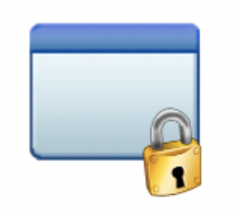
Transferring files between unix / Linux servers
The ssh Linux command is a suite (collection) of utilties to allow the user to securely connect among Unix / Linux servers, as well as securely copy and transfer files among Unix/Linux servers.
There are two additional utilities in addition to the ssh utility to allow secure transfer of files between computers:
  scp (secure copy)
  sftp (secure file transmission protocol)
SSH / SCP / SFTP

Slide 5
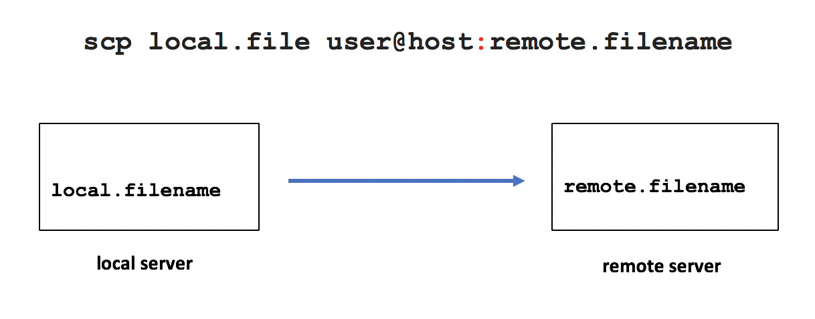
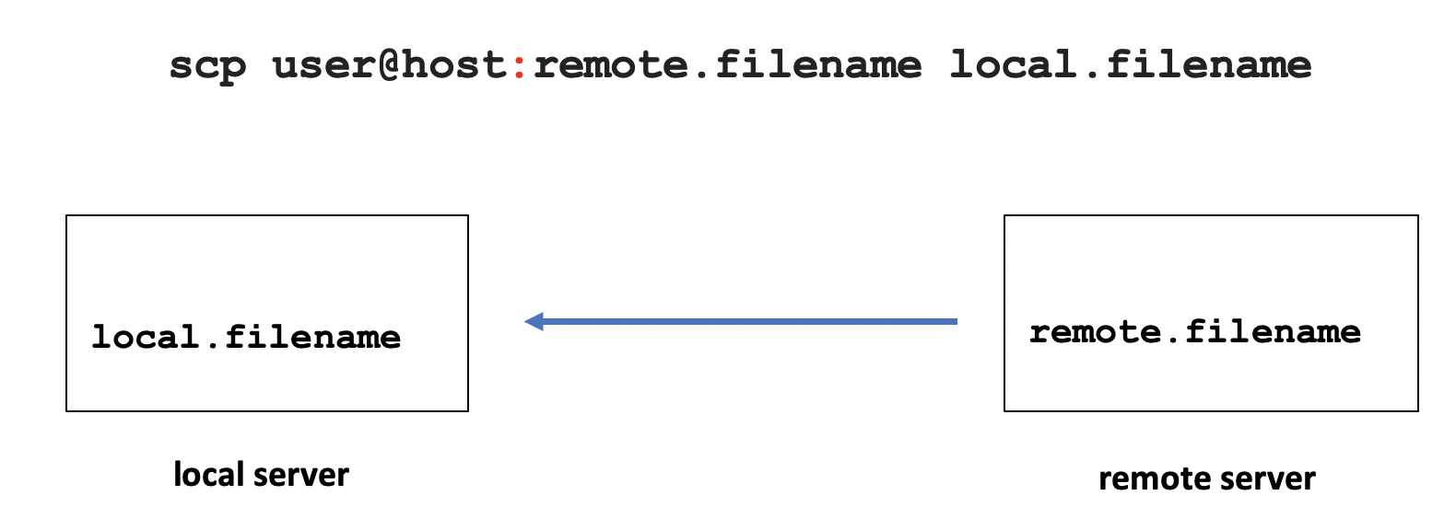
Transferring files between unix / Linux servers
Secure Copy (scp)
Usage:
scp local.file user@host:destination-pathname
scp local.file user@host:
scp user@host:file-pathname local-pathname
The usage for the scp command is like the cp command
with the addition of host names.
The most common mistake that students make is forgetting to add the colon character ":" after the remote hostname.
The username in the command can be omitted if the username is the same on both servers. Multiple file and recursive directory copy
(i.e. option -R) is supported.

Slide 6

Transferring files between unix / Linux servers
Instructor Demonstration
Your instructor will now demonstrate using the scp command.

Slide 7
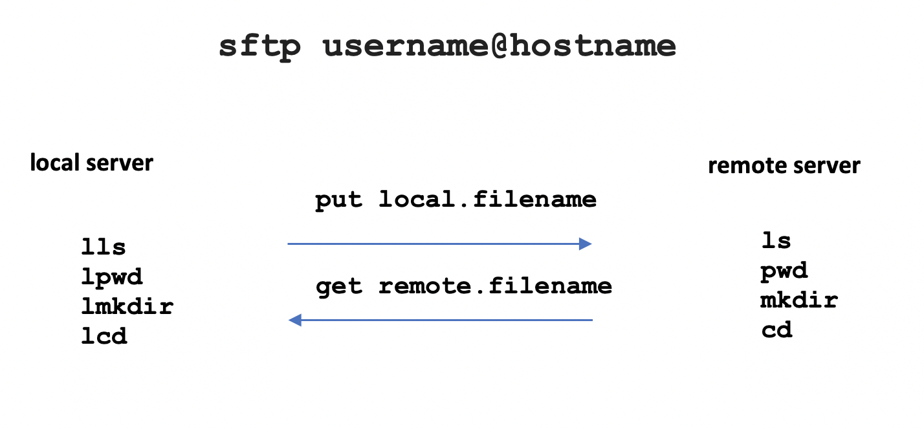
Transferring files between unix / Linux servers
Secure File Transmission Protocol (sftp)
sftp is a utility to connect to a shell that allows a user
to issue ftp commands to access and transfer files
between servers.
FTP is an acronym for File Transfer Protocol
that provides a set of rules on how to convert data that is transferred between computer servers
(both identical and different operating systems).

Slide 8
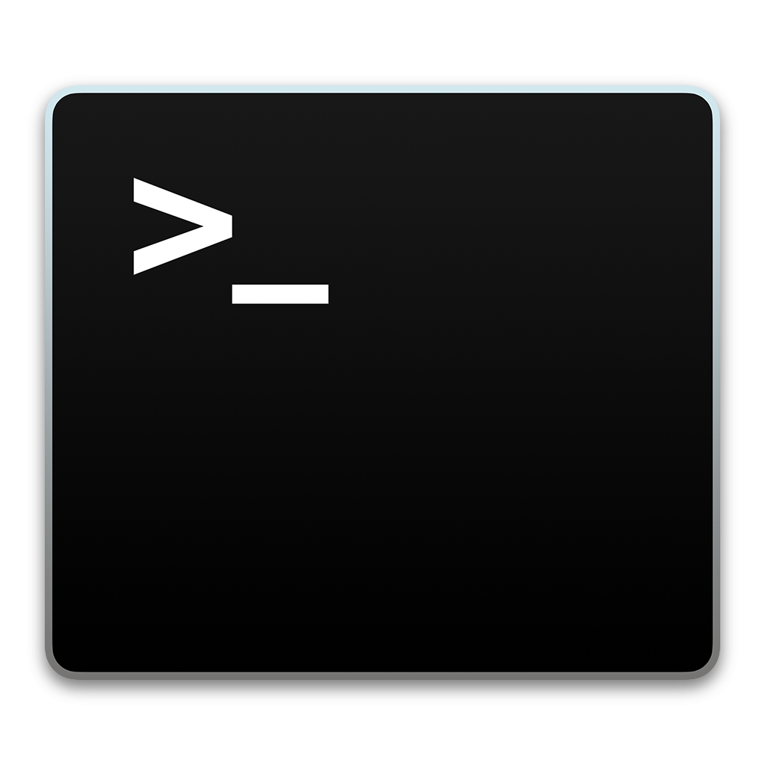
Transferring files between unix / Linux servers
Secure File Transmission Protocol (sftp)
When you login via the sftp command, the sftp command prompt appears. This prompt acts like the Bash shell prompt, but with a limited number of commands.
The table below displays common FTP commands
for transferring files between servers.
Operation | Local Server | Remote Server
Display current working directory | lpwd | pwd
Display directory contents | lls | ls
Create Directory | lmkdir | mkdir
Change directory location | lcd | cd
Upload file to remote server | put
Download file to local server | get

Slide 9
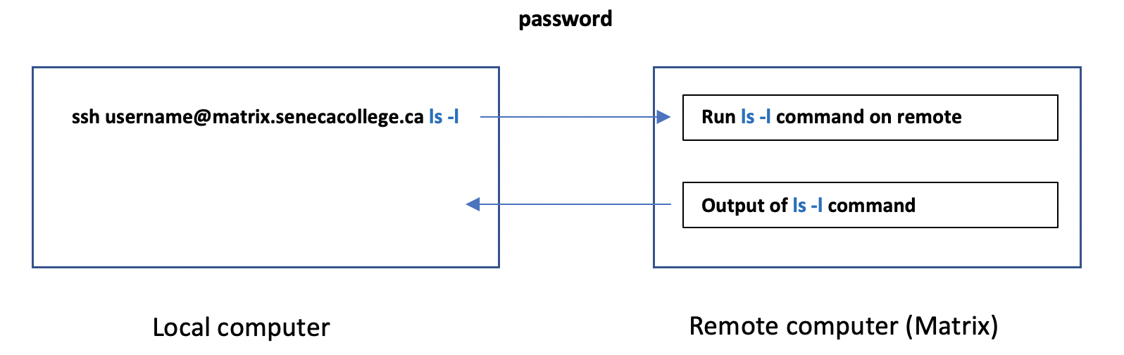
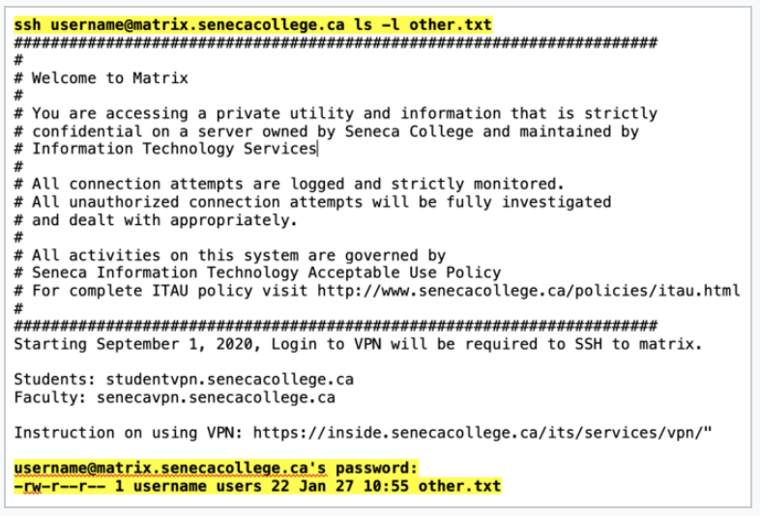
Verifying copied / transferred files
Running Remote Matrix Commands
on your Local Computer
You can use the ssh command to issue Unix/Linux
commands on a remote server without logging
into a remote session.
ssh username@matrix.senecacollege.ca ls -l
You will be prompted for your Matrix account password, then the contents of your home directory in your remote Matrix account will be displayed, although you will remain on your local computer.

Slide 10
Transferring files between unix / Linux servers
Instructor Demonstration
Your instructor will now demonstrate using the ssh command
to issue commands on your remote Matrix server to verify
files have been properly copied / transferred files between computers..

Slide 11
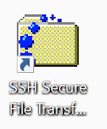
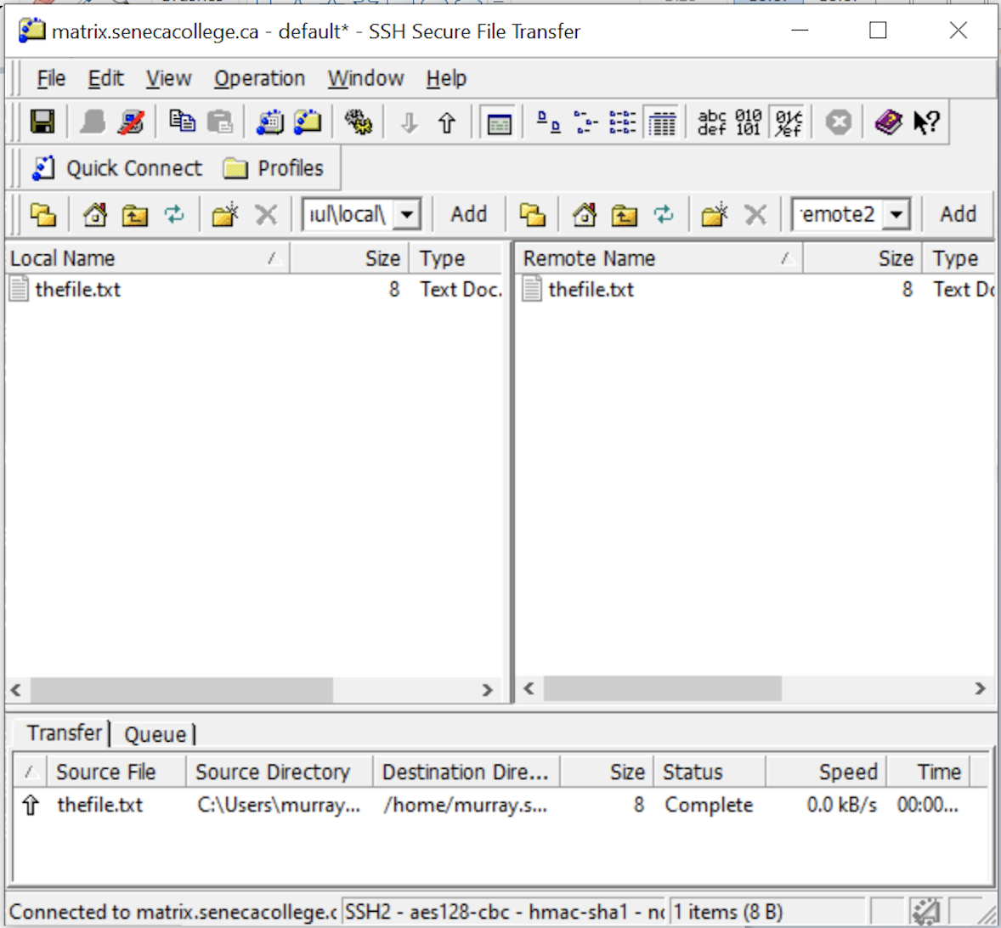
Transferring files between unix / Linux servers
Graphical SFTP Application
Although it is important to learn how to use command-line sftp and is considered coverage for quizzes, midterm and final exams, there are graphical sftp applications to make it more ”user-friendly”.
If your computer is using the MS Windows OS and you
installed the graphical Secure Shell application in
TUTORIAL 1 INVESTIGATION 1, then you can run
a graphical application from your computer desktop.

Slide 12
Transferring files between unix / Linux servers
Instructor Demonstration
Your instructor will now demonstrate using the sftp command
and the Secure Shell graphical SFTP application.

Slide 13

Transferring files between unix / Linux servers
UNIX Mail (mail)
The Matrix server is also an email server that can allow you to send emails messages to other email accounts.
NOTE: In order to use the mail command on a Linux computer at home, you must first install and run an email server and have the appropriate mail client application installed.

Slide 14
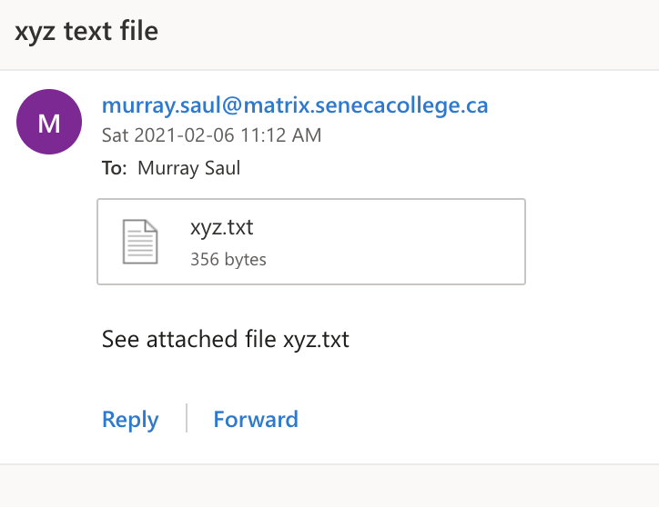
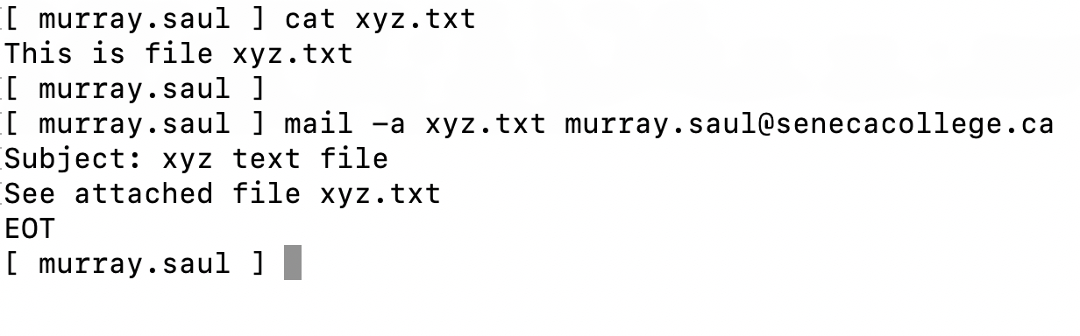
Transferring files between unix / Linux servers
UNIX Mail (mail)
Steps to Send an Email Message:
  Type: mail username@hostname and press ENTER
  Enter subject line and press ENTER
  Type the body of the message and then when finished, press ctrl+d to send message
NOTE: You can use the mail command with the -a option to specify a file to send as an attachment to your email message.
Example:
mail recipient@hostname -a filename

Slide 15
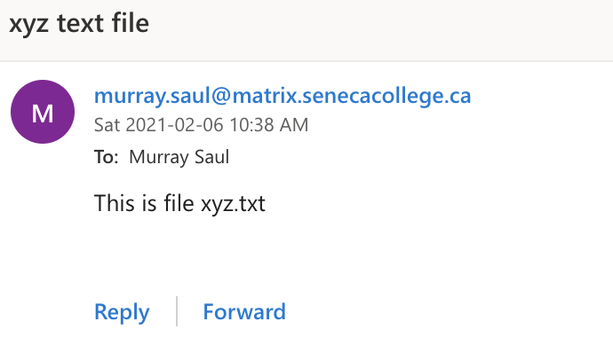
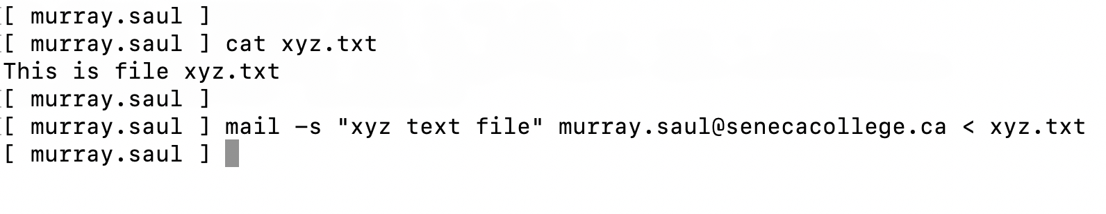
Transferring files between unix / Linux servers
UNIX Mail (mail)
Alternative Method to Send Email with Attachment
Use the -s option in the command to specify the subject line of the command and
use stdin redirection to send a text file as the body of the message.
NOTE: You would have to use this method since you have used stdin redirection to attach
the file’s so you can’t input the subject line from the terminal! You should notice that the contents
of the file are displayed in text in the email message as opposed to a file attachment.
Example:
mail -s "your subject line" recipient@hostname < filename

Slide 16
Transferring files between unix / Linux servers
Instructor Demonstration
Your instructor will now demonstrate using the mail command.

Slide 17
Transferring files between unix / Linux servers
Getting Practice
To get practice perform Week 6 Tutorial:
  INVESTIGATION 1: USING SECURE COPY
  INVESTIGATION 2: USING SECURE FILE TRANSMISSION CONTROL PROTOCOL
  INVESTIGATION 3: USING THE MAIL COMMAND TO SEND FILE ATTACHMENTS
  LINUX PRACTICE QUESTIONS (Questions 1 – 12)

