Slide 1
OSL640: INTRODUCTION TO OPEN SOURCE SYSTEMS Week 7: INSTALLING LINUX / LIVE LINUX DISTRIBUTIONS
Photos and icons used in this slide show are licensed under CC BY-SA

Slide 2
Lesson 1 topics
Installing Linux
Purpose / Linux Distributions
Linux Installation Methods
Live Linux Distributions
Purpose
Run Red Hat Enterprise Linux (RHEL) from your home computer (as a Virtual Machine)
Week 7 Tutorial
INVESTIGATIONS 1 & 2

Slide 3
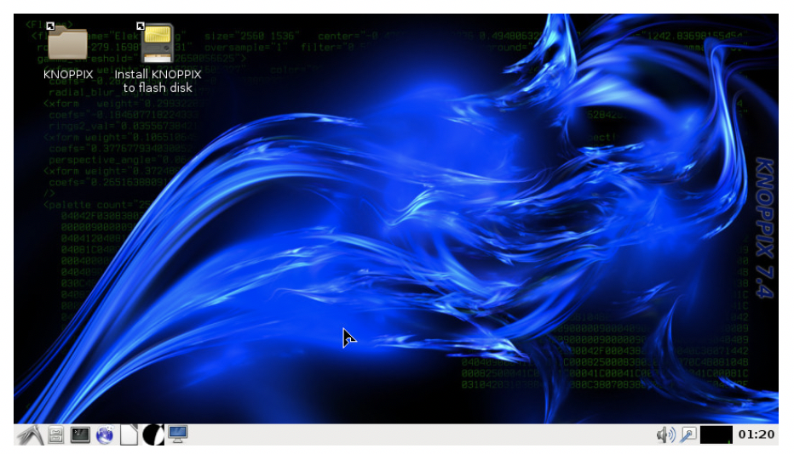
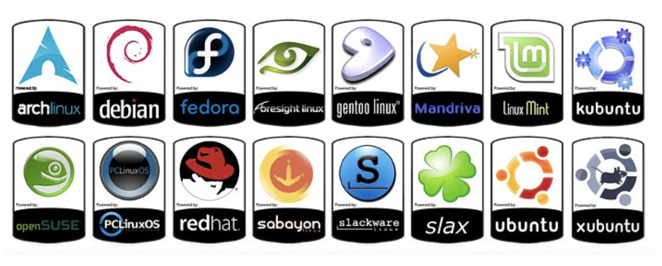
Installing Linux
Having a Linux system on your home computer provides access to a large library of open source software.
Also, installing your own version of Linux on your notebook or desktop computer teaches you how to:
Work in the Linux environment
Run graphical applications
Perform routine Linux OS administration tasks

Slide 4
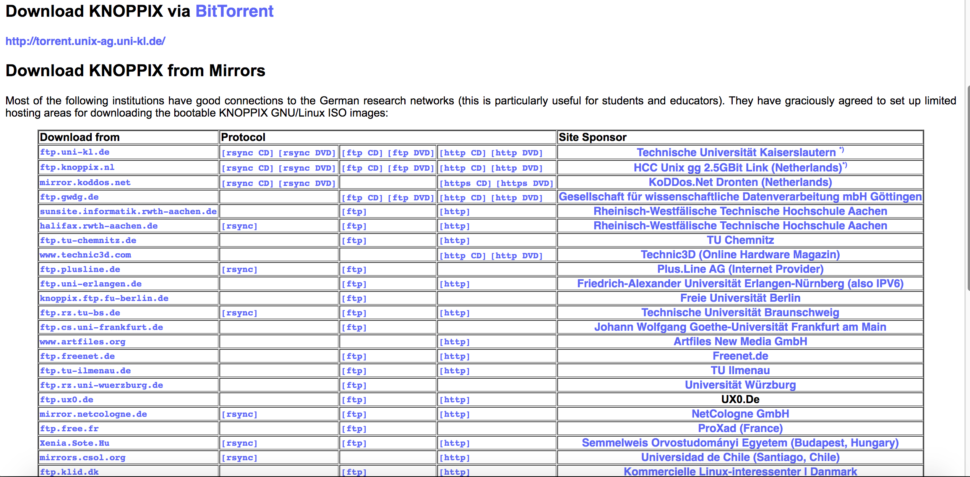
TRADITIONAL LINUX INSTALLATION
STEPS:
Select a Linux Distribution and download a Linux Distribution Install ISO file to your Computer (Note: Be aware of any required Hardware Requirements for the Linux OS prior to installation.) Knoppix Link: https://www.knopper.net/knoppix-mirrors/index-en.html
Burn a Linux Distribution CD/DVD, or USB Key. How to Burn CD: Install Knoppix LInux How to Burn USB Key: How to Boot Knoppix from USB
For most distributions, the installation involves a guided graphical environment.

Slide 5
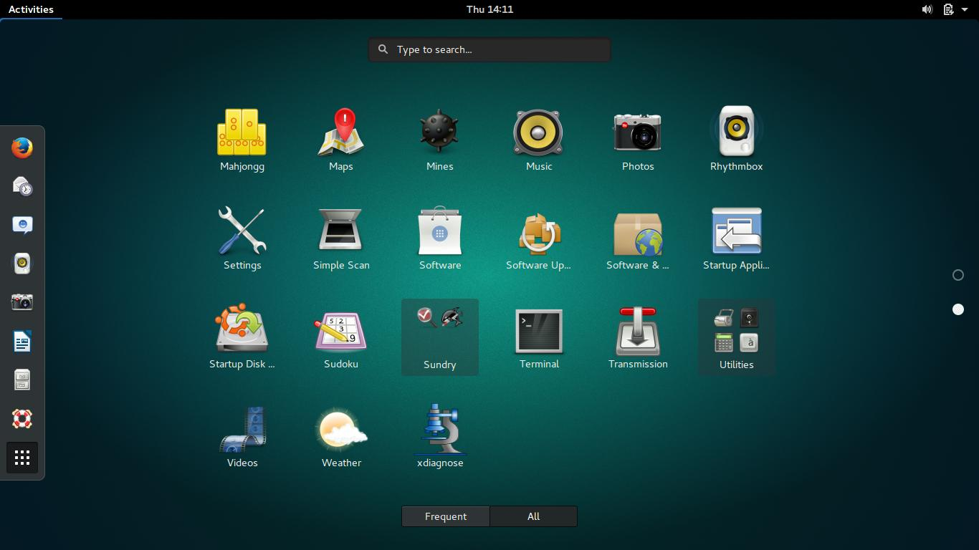
LINUX INSTALLATION METHODS
Standalone Installation
Linux is the only OS on the computer.
Any existing data on disk will be erased.

Slide 6
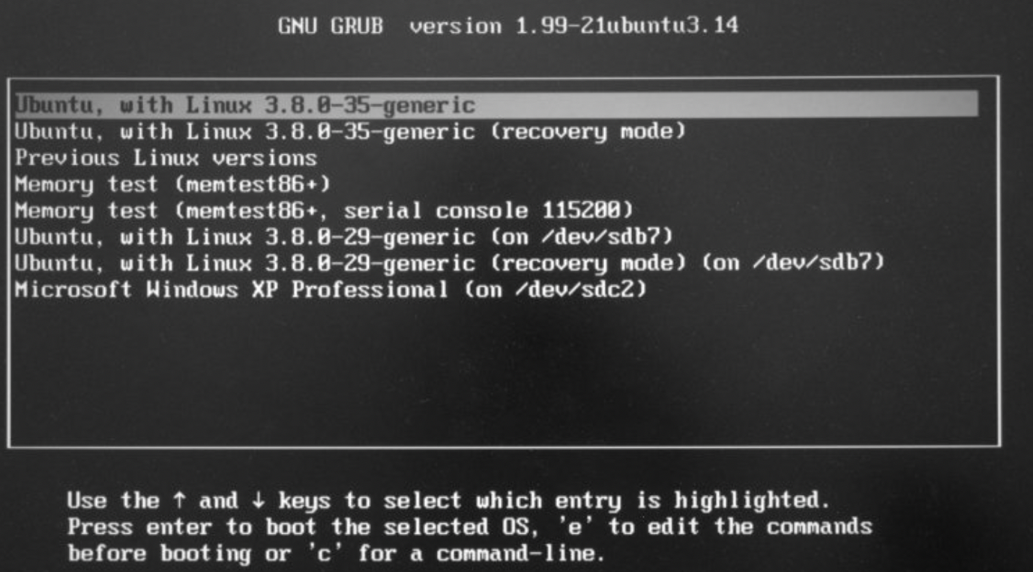
LINUX INSTALLATION METHODS
Dual-boot / Multi-boot Installation
A boot menu allows the user to select the desired OS.
Advantages of Dual-Boot or Multi-Boot:
This option provides a method to access your computer if one OS fails to boot-up.
Access the Windows partition if your Windows OS cannot boot-up.
This booting method is great for troubleshooting (for example: boot into Linux OS to eliminate a hardware issue).
Installation Tips:
It is recommended to back up important data before proceeding.
It is recommended to install the Linux operating system last, as other operating systems may NOT offer a multi-boot option.

Slide 7
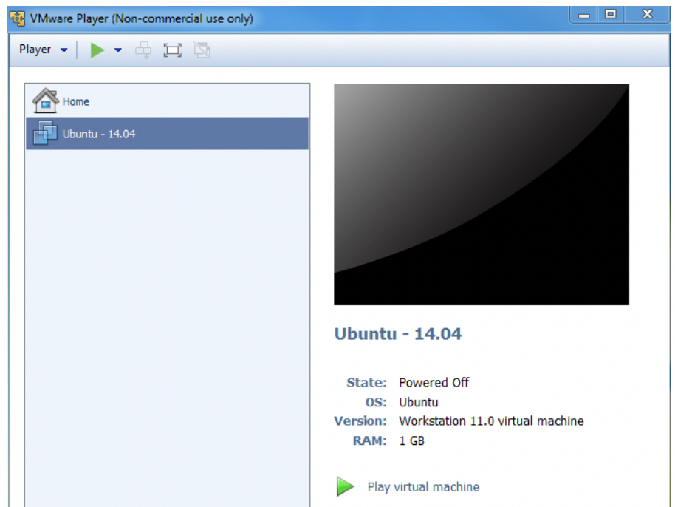
LINUX INSTALLATION METHODS
Virtualization Machine Installation
Virtualization is the process of running a virtual instance of a computer system in a layer abstracted from the actual hardware. Reference: https://opensource.com/resources/virtualization
The virtualized (guest) operating system is installed and run in a window under another (host) computer’s operating system. Special software is used to manage the entire process, referred to as the hypervisor.

Slide 8
LINUX INSTALLATION METHODS
Virtualization Machine Installation
Advantages of Virtualization:
You can run VM from an ISO image file or a VM file.
One or more virtual machines can be run at the same time.
The guest OS shares hardware with the host OS and possibly other virtualized systems.
The guest systems have network access through the host.
Installation Tips:
Virtualization requires a compatible processor: not all processors support that feature.
Your BIOS should be set to enable Virtualization.
Popular VM software for Windows, Apple and Linux OS include:
VMware
Oracle Virtual Box

Slide 9
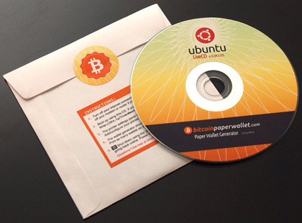
RUNNING Live linux
Live Linux CD/DVD/USB
A live CD (also live DVD, live disc, or live operating system) is a complete bootable computer installation including operating system which runs directly from a CD-ROM or similar storage device into a computer's memory, rather than loading from a hard disk drive. A Live CD allows users to run an operating system for any purpose without installing it or making any changes to the computer's configuration. Live CDs can run on a computer without secondary storage, such as a hard disk drive, or with a corrupted hard disk drive or file system, allowing data recovery. Reference: https://en.wikipedia.org/wiki/Live_CD

Slide 10
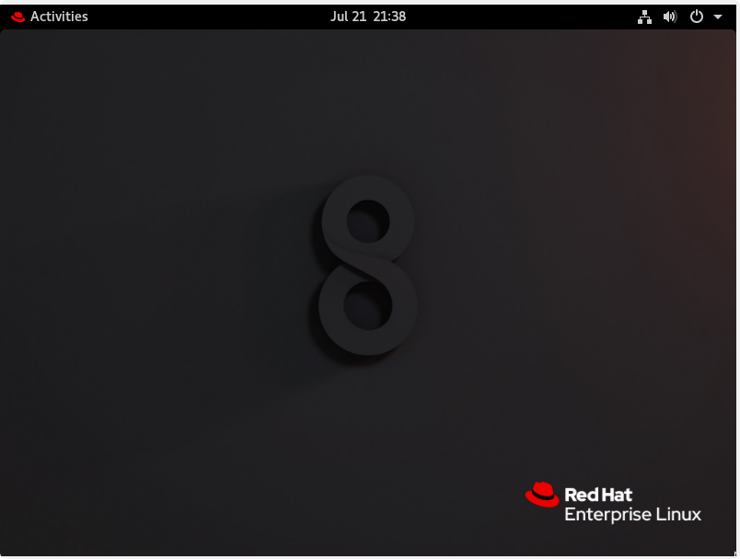
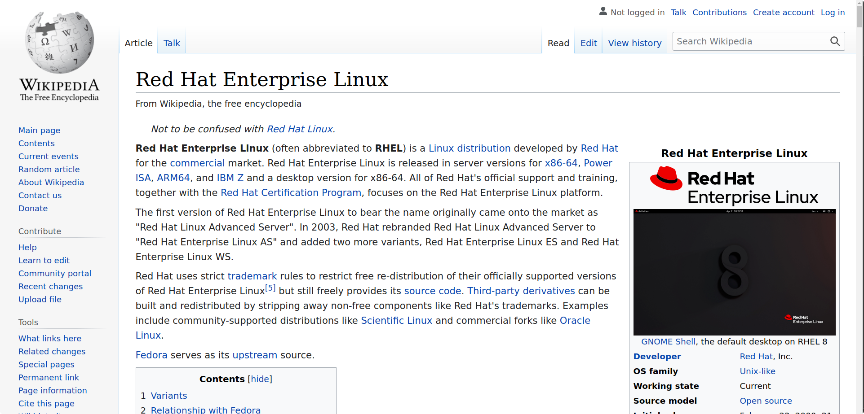
iNSTALLING LINUX (RED HAT ENTERPRISE LINUX)
Tutorial 7 (in OSL640 WIKI)
Tutorial 7 contained in the Weekly Schedule of the OSL640 WIKI allows a person to install the Red Hat Enterprise Linux as a Virtual Machine. This can be useful for many tasks such as testing server configurations or code (web pages and databases) in a virtual test (or development) environment before deploying to a live (or production) server.
In this tutorial, you will install a virtual machine, install some software within that virtual machine and connect to the matrix server. These skills will be used in OSL740.

Slide 11
Live linux
Getting Practice
You can get practice by performing the Week 7 Tutorial:
INVESTIGATION 1: CREATING A RED HAT ACCOUNT AND DOWNLOADING THE ISO
INVESTIGATION 2: CREATING A VIRTUAL MACHINE IN VMWARE AND INSTALLING RED HAT ENTERPRISE LINUX
LINUX PRACTICE QUESTIONS

Slide 12
Lesson 1I topics
Administrative Access
Super User (Root)
Sudo, Visudo
Common System Administration Tasks
Testing network connectivity: ping
Installing software using your package management tools: dnf in Red Hat Enterprise Linux (RHEL)
Week 7 Tutorial
INVESTIGATION 3

Slide 13
Root aka super user
One of the things that makes Linux secure and less susceptible to viruses is the need for Root access to install software.
The root user aka super user has full administrative access to the system.
For this reason you should be very careful what you are doing any time you switch to the root user to execute commands.
Commands like rm –rf /* can be extremely damaging to a Linux system if executed with elevated (root) privileges (Warning: Do not ever execute this command). Why?

Slide 14
Switching to root
You can switch to the root user (assuming you have the password) by issuing the command su without any argument (or alternatively su -).
DO NOT try this in Matrix, as unauthorized attempts to switch to root are logged. An excessive number of these could get you into trouble.

Slide 15
sudo
As you can imagine providing all users who require administrative access the root password is highly insecure. Fortunately, there is another command in Linux that is a better option for this (and commonly used in industry). This is sudo.
Sudo originally stood for superuser do (and is still commonly referred to this way), though the meaning has been expanded to substitute user do as you can use sudo for more than just running commands with root (elevated) privileges.
Using sudo is like “Run as Administrator” in Windows. You would issue the sudo command in front of any command you wish to execute with root (elevated) privileges. You will then be prompted for your password. IF the system has been configured to allow you sudo access, your command will execute.
One of the advantages to having administrators use sudo instead of switching to root is any changes made on the system while using sudo are logged to the system log using your regular user.
Additionally, users can be configured to have access to only certain commands via sudo.

Slide 16
visudo
In Linux, everything is a file. This is an important concept to remember when configuring systems and network services.
Who is allowed to issue the sudo command is detailed in the file /etc/sudoers.
While you can edit this file directly using a text editor like Vi or Nano, it is not recommended.
Instead you should edit this by using the command visudo.
visudo puts you into a special editing mode allowing you to edit the file while simultaneously locking the file (so two users cannot edit it at the same time) and checking the file for correct syntax.

Slide 17
Testing network connectivity
In NWK680 you should have learned about the ping command, which is used to test network connectivity.
Ping works the same in every Operating System (Cisco ISO, Windows, Linux or macOS).
Ping can be used to test connectivity to an IP address or Fully Qualified Domain Name (FQDN).
Simply issue: ping followed by the IP address or FQDN you wish to try to reach.
Linux requires a network connection to install software or update the system. It is a good idea to test your network connection using ping before trying to do this.

Slide 18
Package management / installing software
Installing software in Linux requires both an active Internet connection and knowledge of which package management tool to use for your distribution (or distro). Linux software and updates come from special sources hosted on other servers, known as repositories (or repos). All the major Linux distros host their own repos, though anyone can host a repository for a distribution - and many organizations do. Due to the Open Source nature of Linux, certain repos may contain specialized software that is not available in the main repository (such as EPEL - Extra Packages for Enterprise Linux); or they may contain a mirror of the main repo.
Red Hat based Linux distributions use DNF (Dandified Yum).
This an update of YUM (Yellowdog Updater, Modified).
Both of these operate as a front end for RPM (Red Hat Package Manager). These are used in Red Hat based Linux distros, such as Red Hat Enterprise Linux and Fedora. The advantages of DNF and YUM over RPM is that they resolve dependencies (meaning if the software you are installing requires other software, they will install that as well). RPM does not do this, which can lead to a situation commonly referred to as dependency hell in industry.
Installing software or updates always requires root or sudo access.

Slide 19
Installing software
Getting Practice
You can get practice by performing the Week 7 Tutorial:
INVESTIGATION 3: INSTALLING THE GLOBAL PROTECT VPN AND CONNECTING TO MATRIX FROM YOUR VIRTUAL MACHINE
LINUX PRACTICE QUESTIONS

